Slide 1
Uber Data Analysis
Suvro Banerjee, 08/30/2015

Slide 2
Initial Data Set
JSON dataset of client logins from an Uber city is given below.
2012-03-01T00:05:55+00:00
2012-03-01T00:06:23+00:00
…………………………………………
Read the dataset in R using “rjson” package. The data has the following characteristics.
There are total 22447 rows and 1 column.
The data has information at the time level (hour, minute and second)
Start Date: "2012-03-01 00:05:55 UTC" i.e. 1st March 2012
End Date: 2012-04-30 23:59:29 UTC” i.e. 30 th April 2012
Total 2 months of raw data.

Slide 3
Extracting the features
Convert to datetime using “lubridate” package.
Extract the following features:
Year
Month
Day
Hour
DateTime Year Month Day Hour
1 2012-03-01 00:05:55 2012 3 1 0
2 2012-03-01 00:06:23 2012 3 1 0
3 2012-03-01 00:06:52 2012 3 1 0
4 2012-03-01 00:11:23 2012 3 1 0
5 2012-03-01 00:12:47 2012 3 1 0
6 2012-03-01 00:12:54 2012 3 1 0

Slide 4
Aggregate the data set
Aggregate the dataset by Year AND Month AND Date AND Hour and calculate the Total Number of Logins.
DateTime TotalLogins Year Month Day Hour WeekDay WeekDayName
1 2012-03-01 00:00:00 31 2012 3 1 0 5 Thursday
2 2012-03-01 01:00:00 18 2012 3 1 1 5 Thursday
3 2012-03-01 02:00:00 37 2012 3 1 2 5 Thursday
------------------------------------------------------------------------------------------------
1459 2012-04-30 18:00:00 7 2012 4 30 18 2 Monday
1460 2012-04-30 19:00:00 8 2012 4 30 19 2 Monday
1461 2012-04-30 20:00:00 13 2012 4 30 20 2 Monday

Slide 5
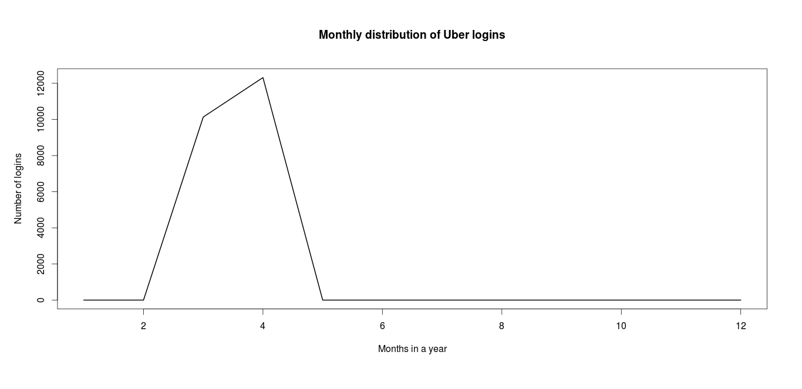
Total Number of Logins grouped by Month
Data is only available for the month of March & April.
Total number of logins have increased in April than in May.

Slide 6
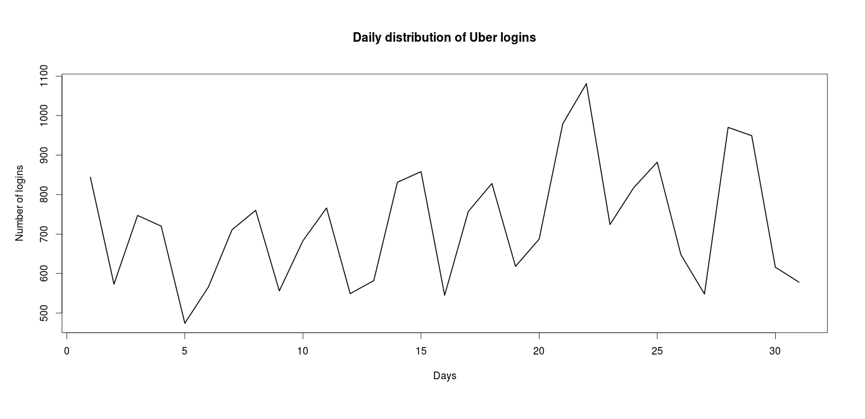
Total Number of Logins grouped by Day of the Month
The high peaks in Total Number of Logins are seen at the end of the month.
After every 2 days there is a peculiar low demand, may be back in 2012, Uber was more of a luxury than a necessity.

Slide 7
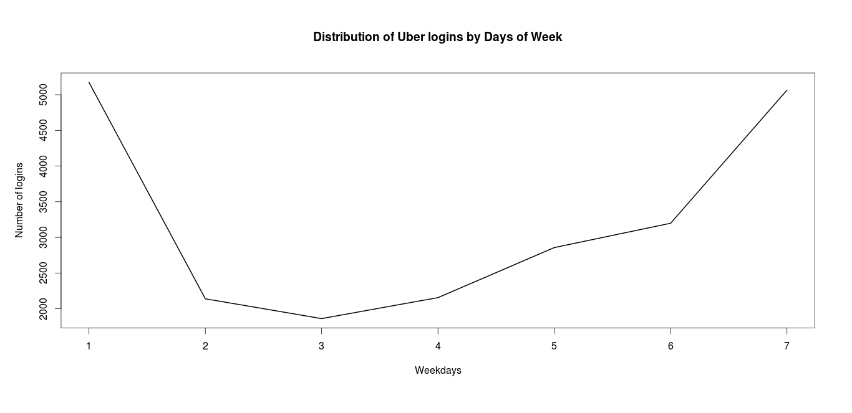
Total Number of Logins grouped by Day of the Week
Note: Number 1 corresponds to Sunday and so on.
High demand on Friday, Saturday and Sunday.
Low demand on Monday, Tuesday and Wednesday.
Medium demand on Thursday.

Slide 8
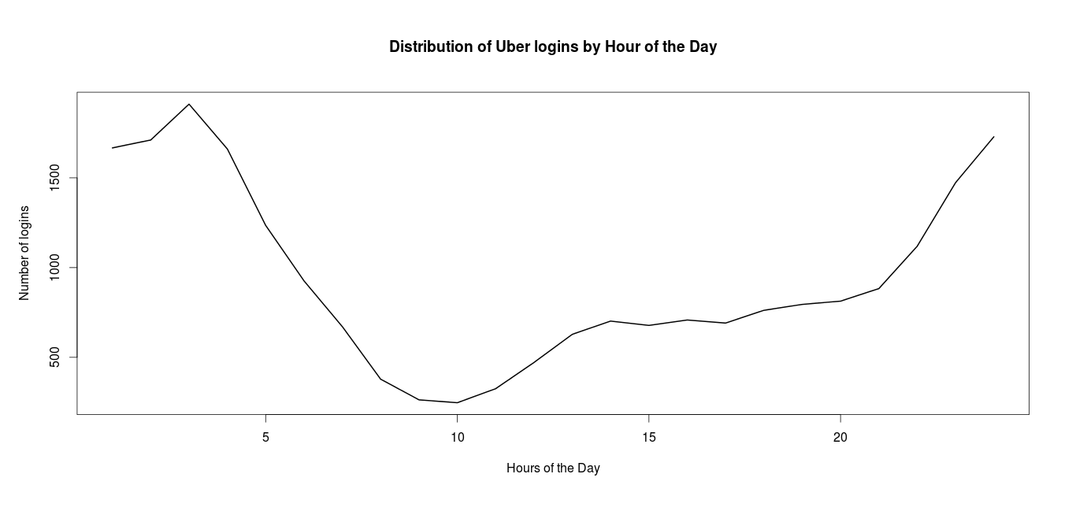
Total Number of Logins grouped by Hour of the Day
The highest demand is at 3 am.
The lowest demand is at 10 am
From 8pm to 5am the demand is high.
From 8am to 11am the demand is low.
Rest of the time the demand is medium.

Slide 9
Time Series Analysis
Fit the ARIMA model using auto.arima() which chooses the best value of p (autoregressive terms), q (moving average terms) and d (number of differencing terms) using the following characteristics of the time series object.
Unit Root Test : To make the series stationary using the
KPSS Test which looks for the Deterministic Trend and
ADF Test which looks for the Stochastic Trend.
Seasonality Test
Looking at ACF (Autocorrelation Function) and PACF (Partial Autocorrelation Function
Taking the minimum value of the AIC to choose the best values of p, d & q.

Slide 10
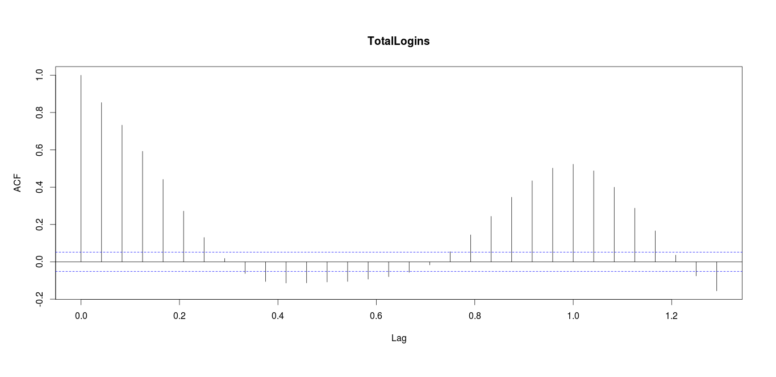
ACF Plot
There are high spikes in Lag-1 and also thereafter.
Need to check the PACF if the higher order lags are the result from the previous lags.

Slide 11
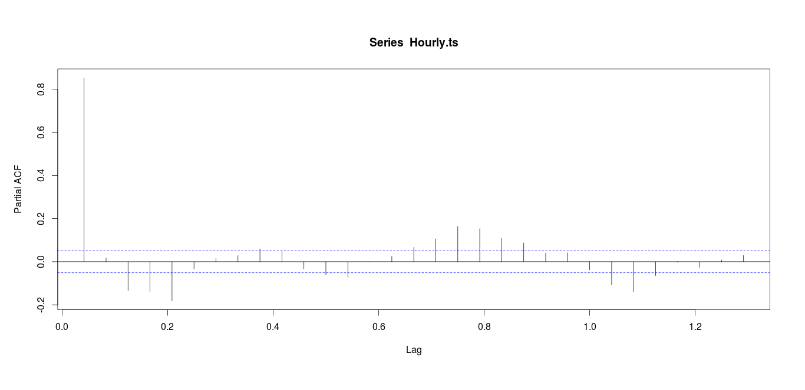
PACF Plot
The spikes diminishes after the 1st lag, so there is a possibility of 1st differencing the time series object.

Slide 12
The best model
Hourly.auto.arima.fit = auto.arima(Hourly.ts, d = NA, D = NA, max.p = 3,max.q = 3,
max.P = 2, max.Q = 2, max.order = 3, start.p = 2, start.q = 2,
start.P = 1, start.Q = 1, stationary = FALSE, seasonal = TRUE,
ic = c("aic"), stepwise = TRUE, trace = FALSE,
approximation = FALSE, xreg = NULL,
test = c("kpss", "adf", "pp"), seasonal.test = c("ocsb", "ch"),
allowdrift = FALSE, lambda = NULL, parallel = FALSE, num.cores = NULL)
The best model is the Seasonal ARIMA model ARIMA(1,1,0)(1,0,0) with frequency = 24 hrs.
The coefficients are as follows. The t-statistics is far greater than 1.96 and hence these coefficients are statistically significant.
ar1 sar1
-0.1866 0.263
s.e. 0.0276 0.027

Slide 13
Model interpretation
Here the SARIMA model has two parts, Non-Seasonal (p, d, q) and Seasonal (P, D, Q).
In this exercise, to forecast the Number of Logins we first took a difference (Lag-1) of the time series object to make it stationary.
To forecast this series we have estimated the coefficient AR1 for both Nonseasonal and Seasonal effects with the period of 24 hours.
So, say to predict / forecast tomorrow's login traffic at 10 am you have to use today’s value at 10 am (Seasonality) times normal (Non Seasonal) AR1 (lag-1) of the time series object.

Slide 14
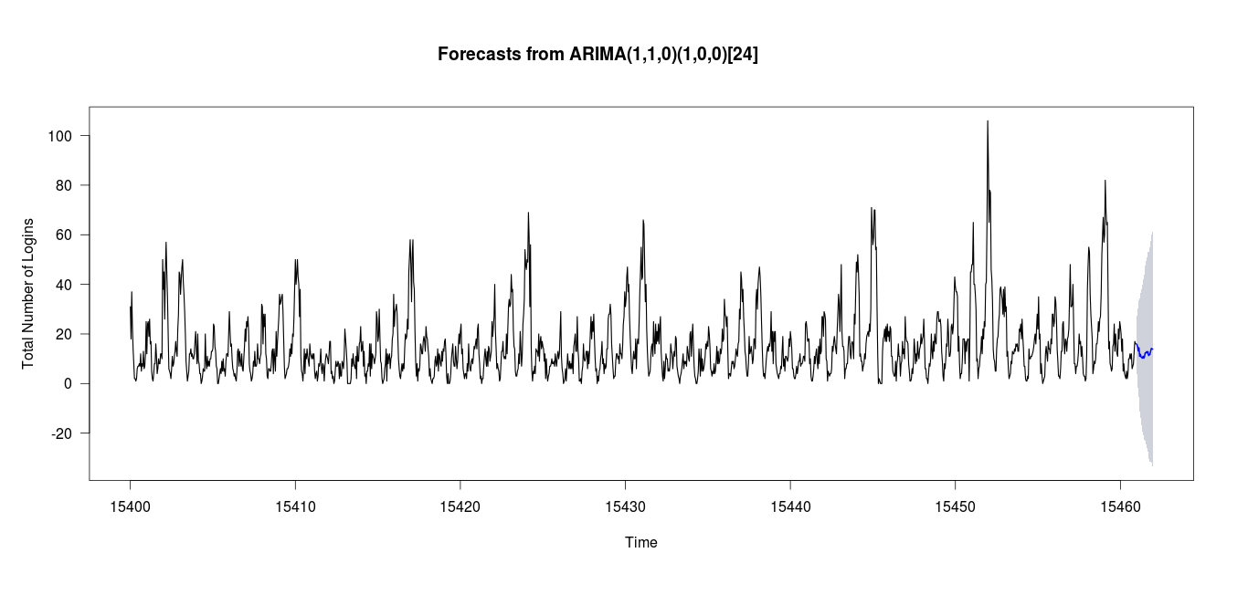
Forecasting
Hourly forecast.
Horizontal axis is the time incremented by 1 hr (The number is an integer value for the time difference from 1970 to 2012 etc. )

Slide 15
Accuracy
The shorter time-interval forecast is more accurate than the longer time-interval forecast.
In longer period, the point forecast doesn’t change so much hence it is incapable of modeling the seasonality and the trend.
The accuracy of the short-term model is given below-
ME RMSE MAE MPE MAPE MASE ACF1
Training set -0.0103186 6.936712 4.992713 NaN Inf 0.6196782 -0.001654817
Note: The source code is written in R and has been sent separately.

Slide 16
Thank you.

